Slide 1
Design of a VR Video Game with game-based learning
A Senior Design Project
BY: Zachary Allen

Slide 2
Report Outline
Motivation
Objective
Design Requirements
Design Constraints
Design Approach
Standards
Game Interactions
The Task Plan
Timeline
Implementations
Conclusion
Acknowledgement

Slide 3
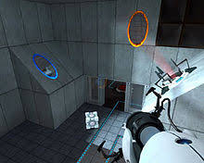

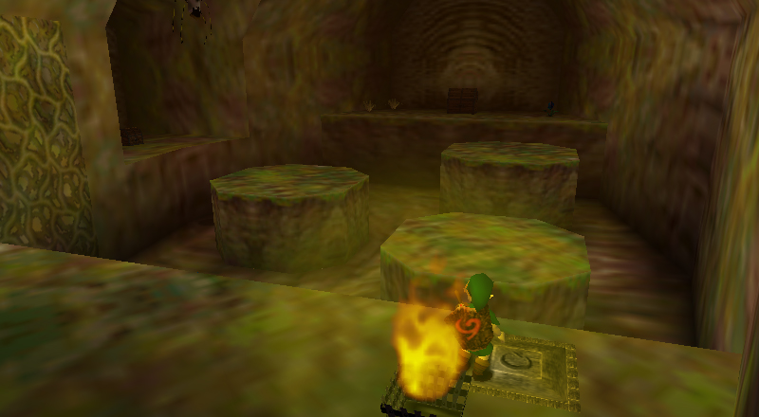
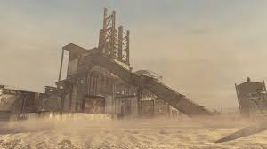
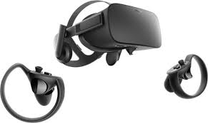
Motivation
My Game Idea
Personal Hobby
Virtual Reality
Notes:
Portal + CoD + TLoZ + VR

Slide 4
Objective
Overarching goal: Create a game for rising engineering students that is engaging to play while also helping them learn various engineering concepts.

Slide 5
Design Requirements
The game should last about 30 minutes on average
Characters and Objects to interact with
5 Puzzles
3 Quizzes
Puzzle + Shooter Action Game
Emphasis on the Digital-Logic Circuit class
Work with virtual reality

Slide 6
Design Constraints
Run on Virtual Reality
Specifically, the HTC Vive
30 Minute cap to prevent headaches
Must be playable in a limited space.
Like the size of a small classroom, for instance.

Slide 7
Design Approach
The story
World Around You
Your Objective
The Puzzles
4 Preset Puzzles
5Q Final Exam
The Characters
You
Enemies
NPCs
Final Boss
The Final Product
Main Setting
The Building
Test Chamber
Puzzles and Halls
Elevator
Main Facility
UI Elements
Health
Location
Checkpoints
Teleportation
Notes:
5Q = 5 Question

Slide 8
Standards
N/A
Notes:
Mention the ESRB!

Slide 9
System Diagram (Game Interaction)
Player
The World
NPCs
Enemies
Puzzles
Solve to advance
Objects
Final Exam
4/5 Correct?
Instant Clear
Else
One Encounter
Talking
Shoot them Down
Pick up
Move Object
Place back down
Moving
Checkpoints
4 different puzzles
Hints available
Teleportation
Then Clear!

Slide 10
Task Plan
Design the Game’s Structure
Create the Game’s Story
Designate Space for the Two Floors
Outline the “Demo” portion of the Testing Chamber Floor
Designate assets from the Asset Store to be used in the project.
Design the First Few Test Floor Rooms
Create and Decorate the Tutorial Room
Create and Decorate the Hallways
Create and Decorate the Archives
Create and Decorate the Decimal-to-Binary Puzzle Room

Slide 11
Task Plan
Create the Game’s UI
Display the Health Bar.
Design Program to Interact with Objects like doors, switches, and the gun
Design player movement.
Program Enemies
The basic enemies
The Fast mooks
The Ray-Tracing Enemies

Slide 12
Task Plan
Create the First 2 Puzzles
Create the tutorial to explain the controls.
Program the Decimal-to-Binary Puzzle
Verify the puzzles function properly.
Finish Designing and Decorating the Test Floor
Program the 3 Quizzes.
Design a Checkpoint System for throughout the game
Create and program the Boolean Algebra Puzzle
Create and program the K-Map Puzzle (Level as in the Instrumentation concept.)
Create the Elevator Room to load into the top floor.

Slide 13
Task Plan
Design and Decorate the Main Floor
Create and Program the D Flip-Flop Puzzle
Design the casual business rooms of the engineering building
Design the Final Boss at the front lobby.
Create a credits sequence for after the game
Verify the program’s entirety
Ensure friendly NPCs and enemies act properly when interacted.
Ensure all systems within the game work properly
Debug the game.

Slide 14
Project’s Timeline
On Week(s)… | Zachary Allen will… | Tasks
1 | Structure the Game | 1A, 1B
2-3 | Map out the Test Floor | 1C, 1D
4-5 | Design the Test Floor | 2A, 2B, 2C, 2D
6 | Build the UI | 3A
7-8 | Build the UI | 3B, 3C
9 | Create some Enemies | 4A, 4B
10 | Build 1st 2 puzzles | 5A, 5B
11 | May’s Showcase | 5C
12-13 | Finish the Enemies | 4C, 4D
14-15 | Continue Test Floor | 6A, 6B
16 | Finish Test Floor | 6C, 6D, 6E
17 | Build the Main Lobby | 7A, 7B
18-19 | Establish the End Game | 7C, 7D
20-22 | Verify the entire game. | 8A, 8B, 8C
Notes:
Could change EASILY.
Also, I may work on this over the summer.

Slide 15
Implementations!

Slide 16
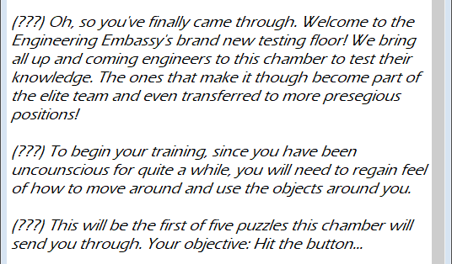
Implementing Subtask 1A
Story Script being finalized
Portal Approach
“Antagonist” influenced by Cave Johnson, too!
Providing background, motivation, and purpose for the trip.
Script excerpt. This character’s name is kept hidden for story reasons.

Slide 17
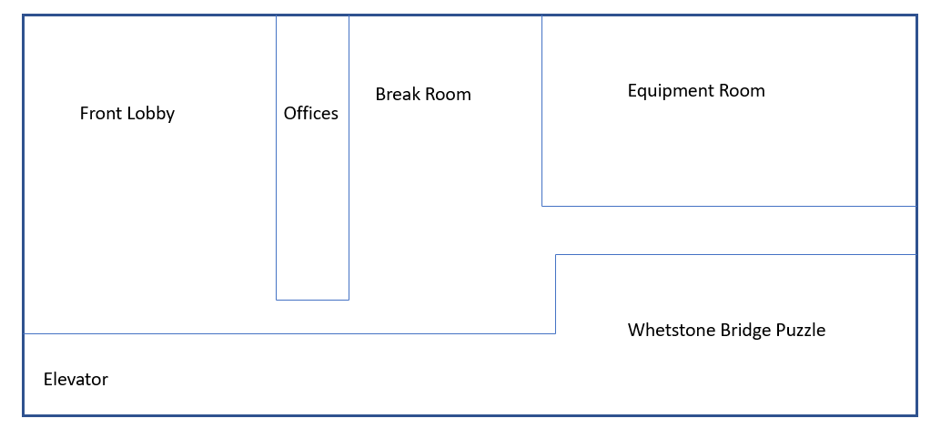
Implementing Subtask 1B
Top Floor = Outside world in this scenario
The final boss is here
Also a lore-haven.

Slide 18
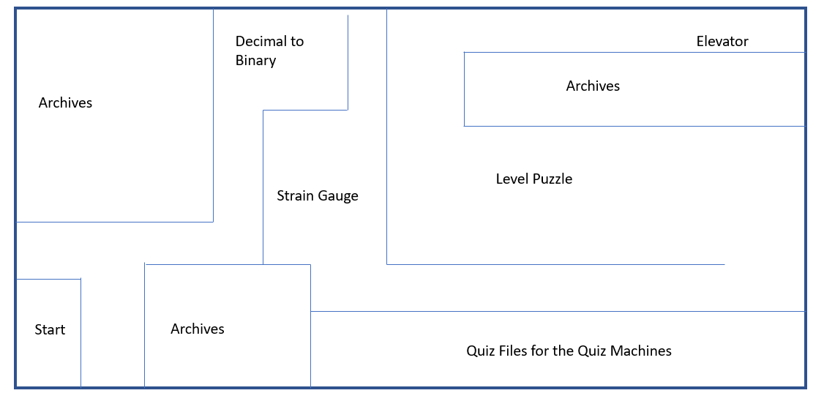
Implementing Subtask 1C
Currently a rough sketch
Majority of the game is here
Goal? The elevator.
Other tasks will take up this main area.
Notes:
Test Floor subject to change

Slide 19
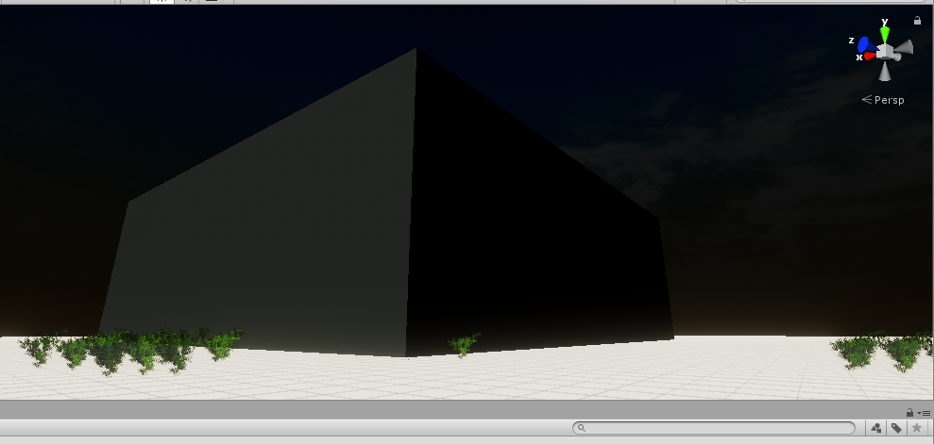
Implementing in Unity (as of April 3)
Implementing tasks 1 and 2
Skybox defined
Still to do:
More Foliage
Grass texture
Better building texture
The inside
Planned to have world designed by 4.10
This screen capture of Unity progress showcases Subtask 1B being implemented.

Slide 20
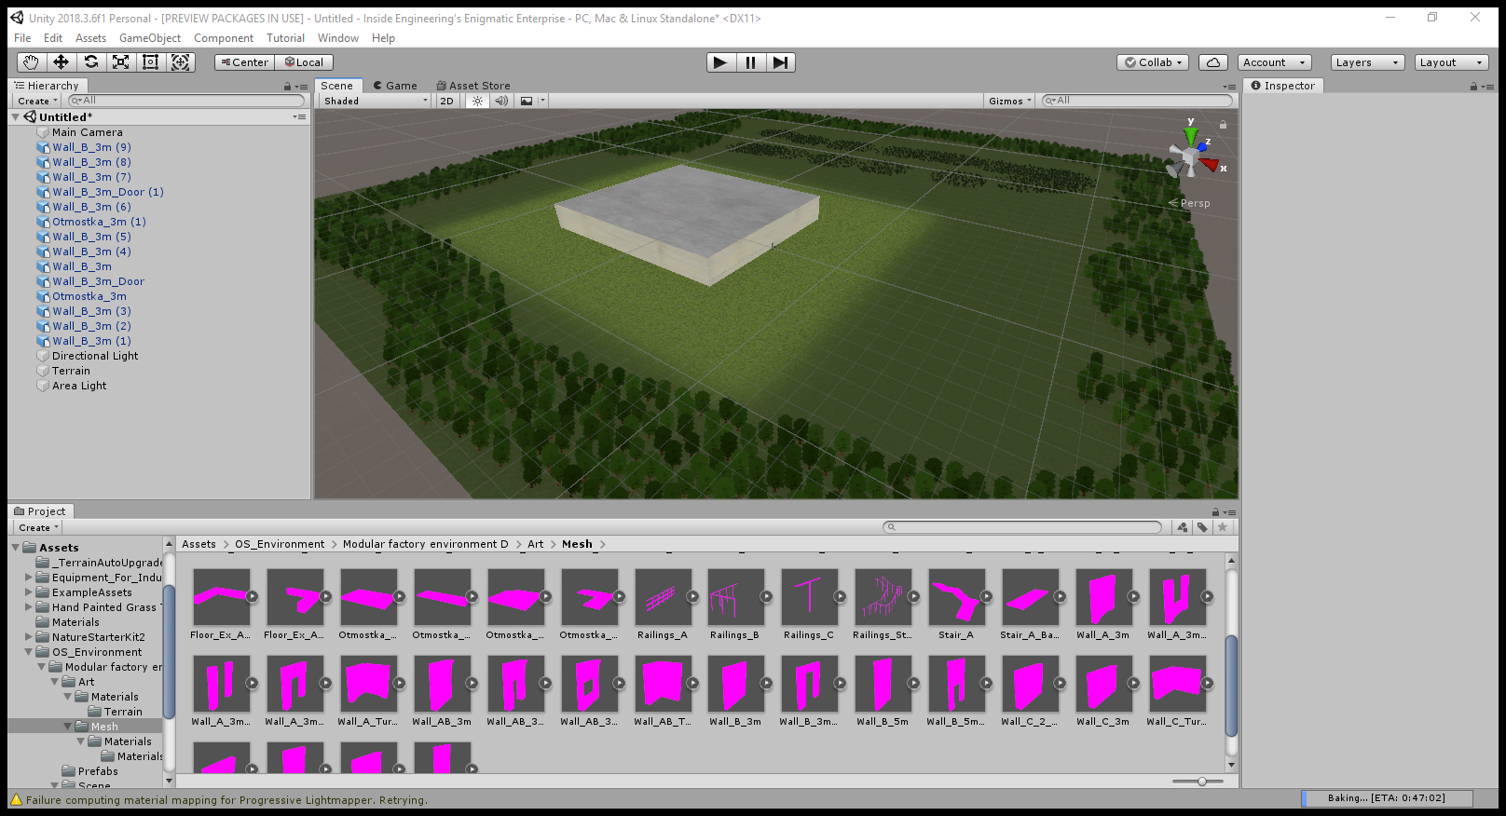
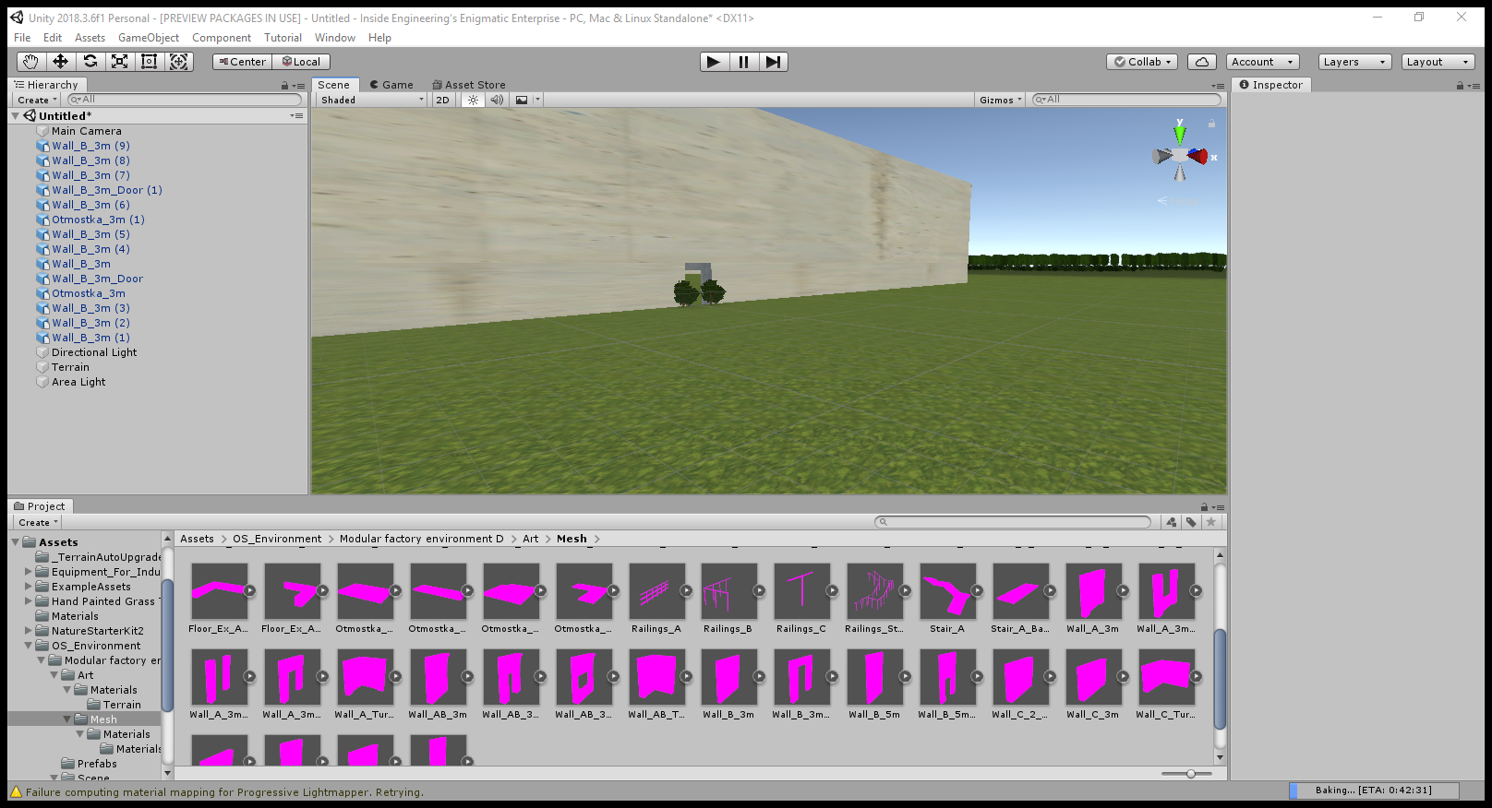
Implementing with Unity (As of April 10)
Outdoors
Front Entrance
Notes:
Ground textures obtained!

Slide 21
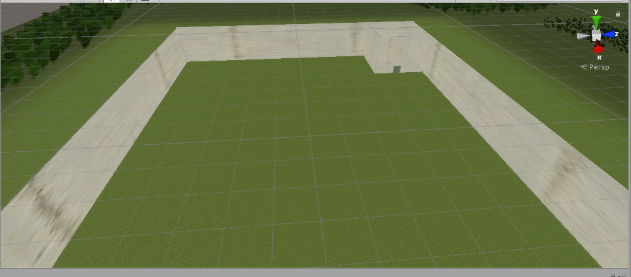
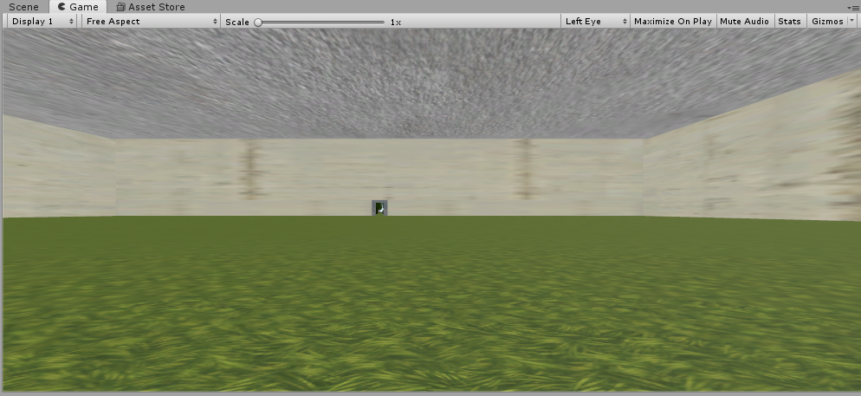
Implementing with Unity (As of April 10)
Overhead Floor Layout
Game View
Notes:
Game View is pointed at the door.
Task 1 is officially complete.
Creating the rooms themselves is Task 2.

Slide 22
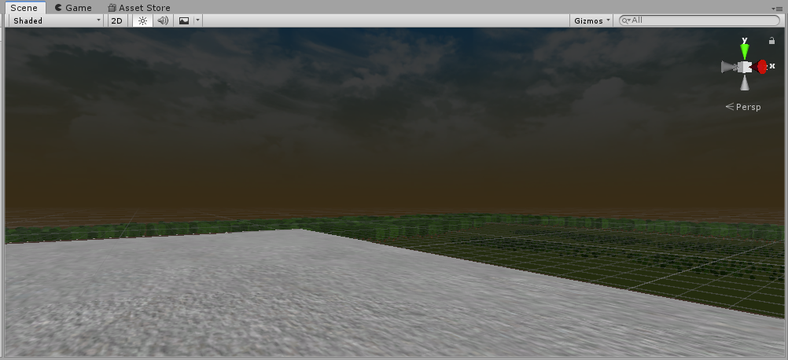
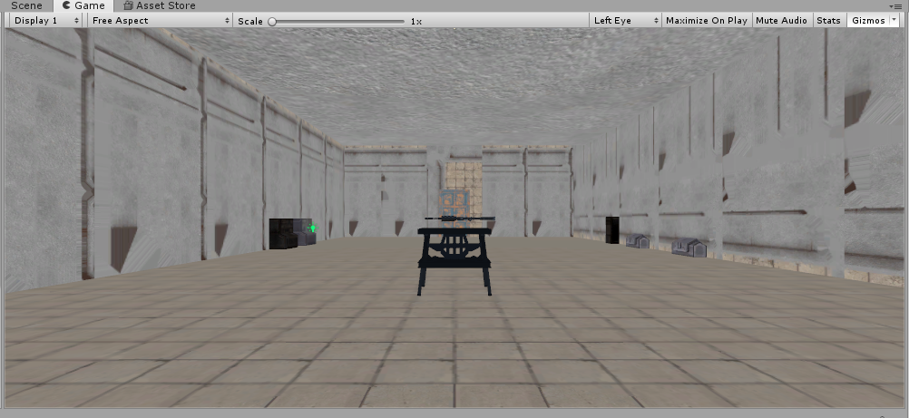
Implementing with Unity (As of April 17)
Updated Outside Skybox
First Room
Notes:
Note: The Testing Floor is another scene. The Elevator Room will be a loading zone to travel between scenes.
Current Issue: Making the textures darker.

Slide 23
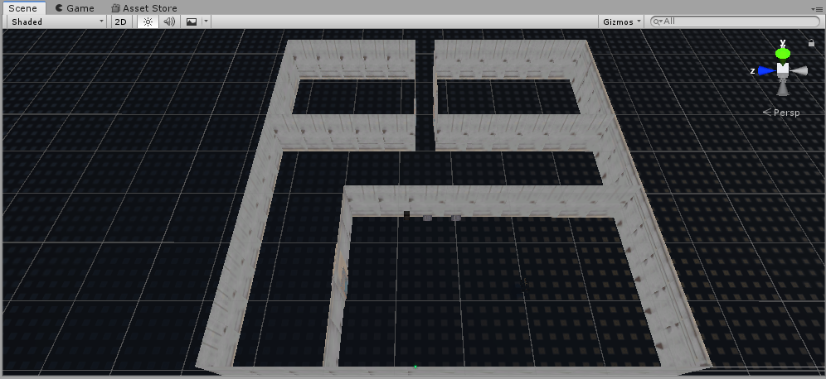
Implementing the Main Floor
Main Room, Starting Hallway, and Two Archives Walled Out!
Remaining Rooms defined by previous sketch.
Currently planned to go to Decimal-to-Binary Room.
Enemies and more decorations to be added!!

Slide 24
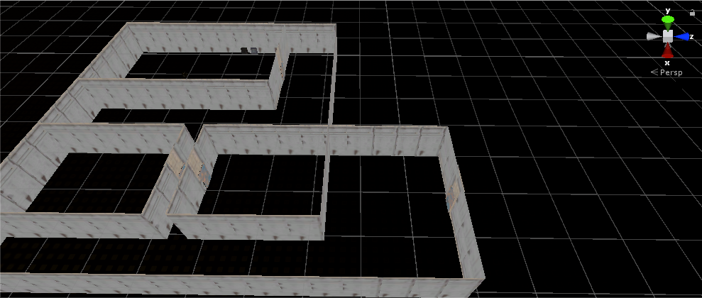
Roadmap of Task 2
Starting Room
Decimal-to-Binary
Archives
Under Construction
Notes:
Needs more Decorations and stuff to add to the atmosphere.
Would walking in place substitute for the VR issue?

Slide 25
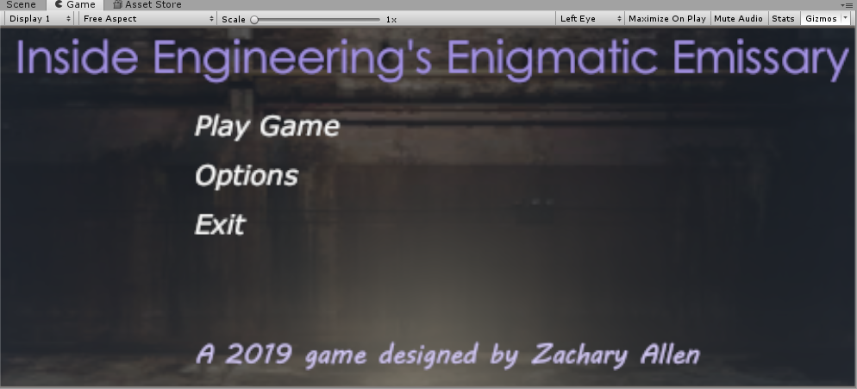
Implementing Task 3: The UI
Here, we have the Main Menu.
Shows Game Title and basic buttons.
Background a Google image search image.
Itself is a separate scene.

Slide 26
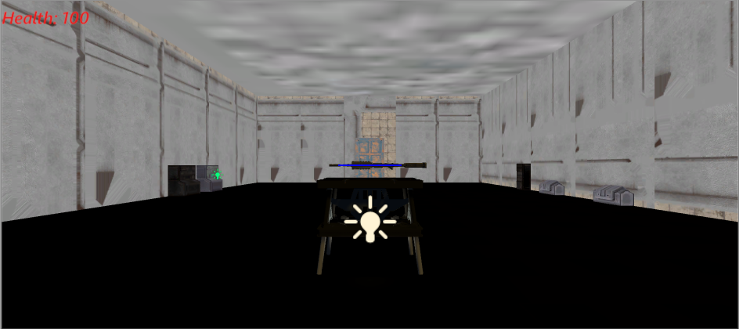
Implementing Task 3: The UI
Health Bar!
Will stay on the screen, too!

Slide 27
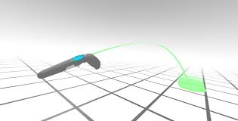
What’s Next!
Streamlined World Organization
Better complement VR movement
Teleportation Feature
Help aid in VR movement
Idea Shown on Right
Altered Puzzles and Quizzes!
Digital-Logic Circuit themed.
Concept of VR Teleportation
Notes:
Decimal-to-Binary Conversion, Boolean Algebra, K-Maps, D Flip-Flops

Slide 28
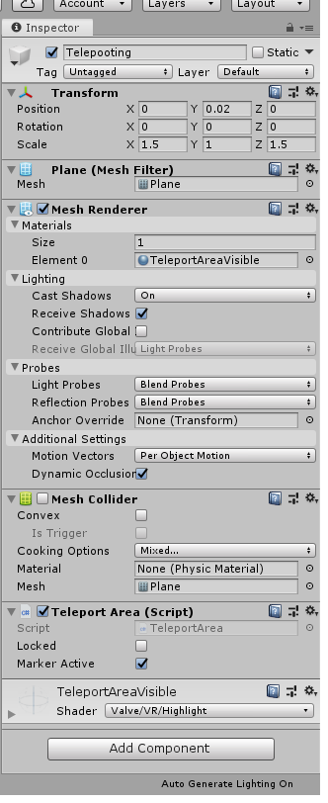
Teleporting
From the SteamVR Asset
Allows teleporting for better VR movement
Based off the “Floor” Plane
Done with the HTC Vive controller.

Slide 29
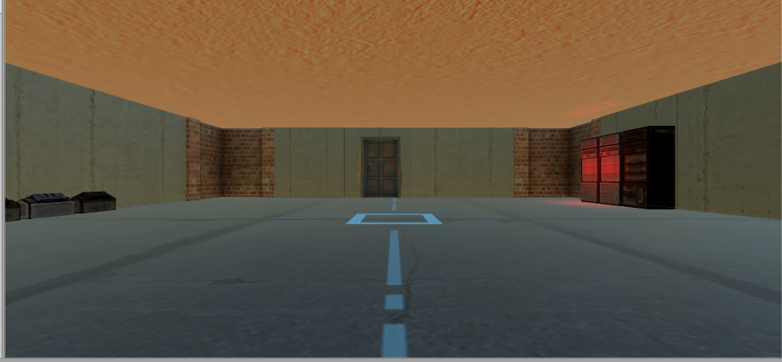
Rebuilding the World One Last time
This time, the world will be better scaled
Each room = One scene
Now using Unity 2019.2.4f1

Slide 30
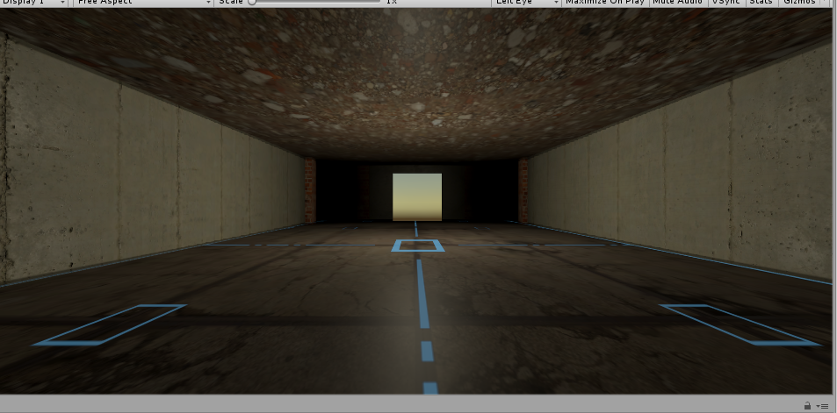
Hallways
All hallways will utilize teleportation
Only one light with 0.9375 intensity.
Will feature enemies.
Longer and more enemies the further into the game.
Also has side rooms.

Slide 31
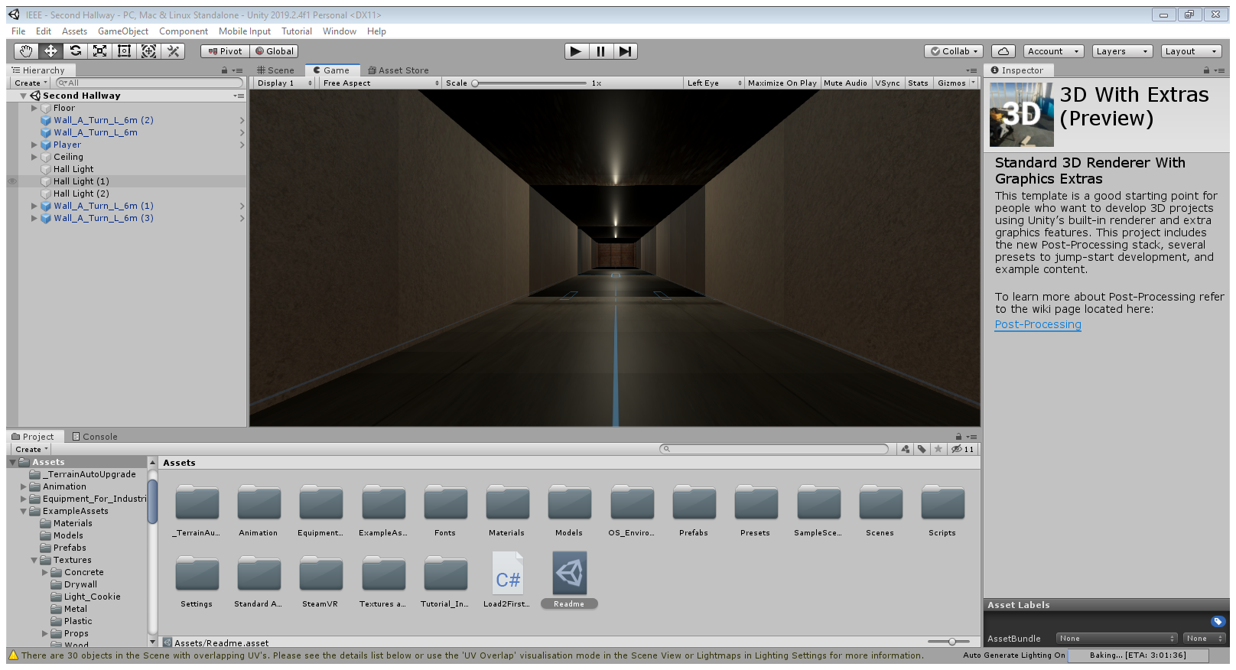
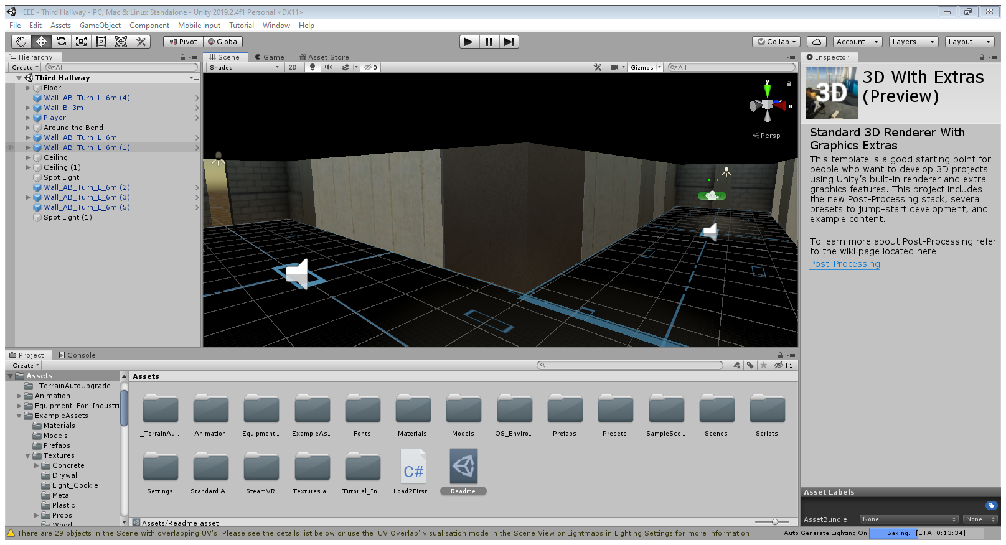
Construction Goes on.
Second Hallway
Third Hallway

Slide 32
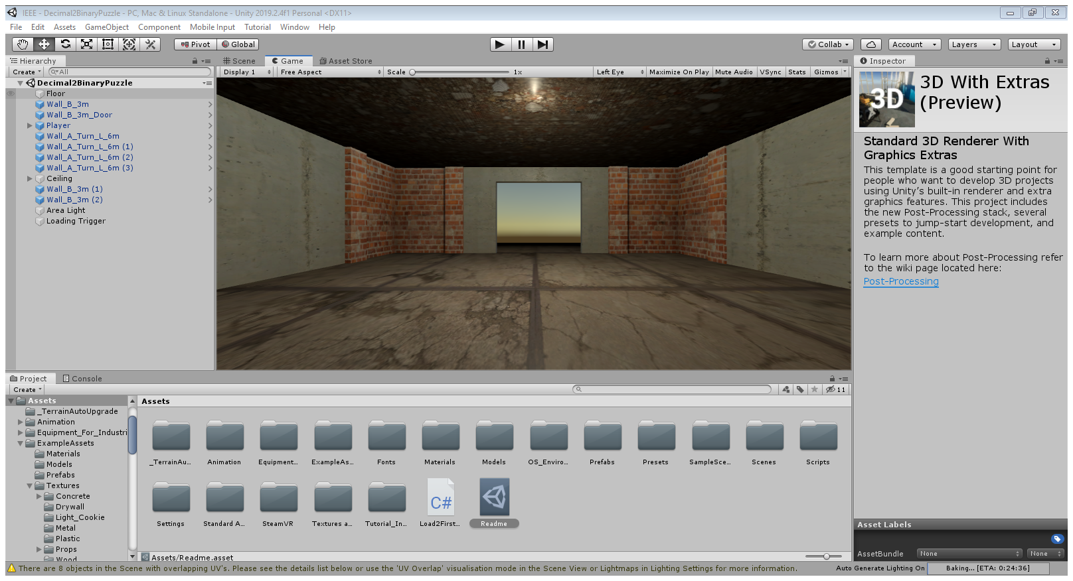
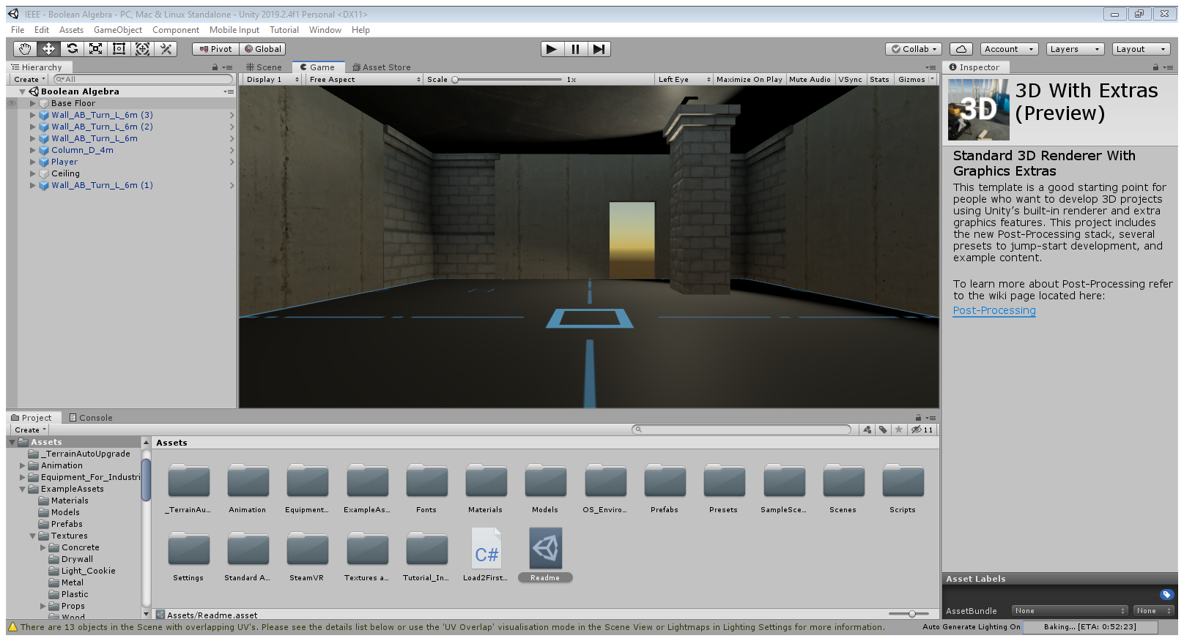
Construction Goes on.
First Puzzle Hub
Second Puzzle Hub

Slide 33
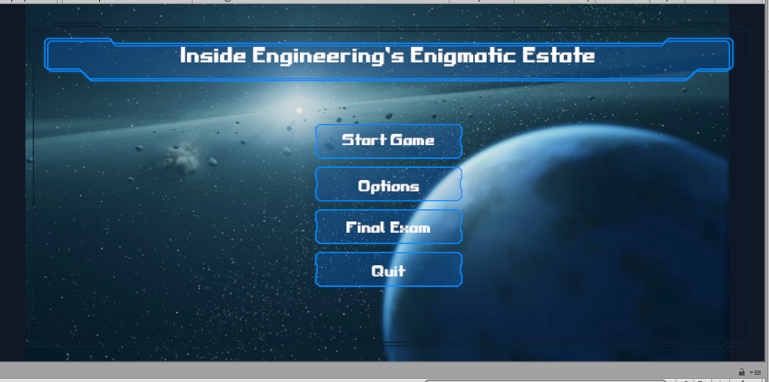
The Menu
Basic options
Emphasis on “Final Exam” option
Quizzes moved to the endgame
Must get 4/5 to succeed
…or face 3 elite enemies simultaneously
Regardless, the game ends afterwards.
Once implemented, professor customizable.

Slide 34

The enemies
From the “BodyGuards” asset
Three types:
One-axis tracking
Damage Sponges
Ray casting tracking
Their goal: Stop your departure from the facility.

Slide 35
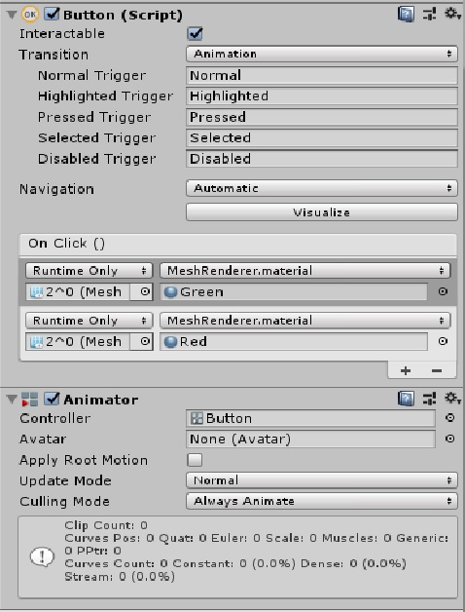
Implementation: D2B Puzzle
Hint and Instructions Provided by 2 Boards
10 Buttons to Press
Right combination of 1s and 0s unlocks the door.
All use a similar script to above.

Slide 36
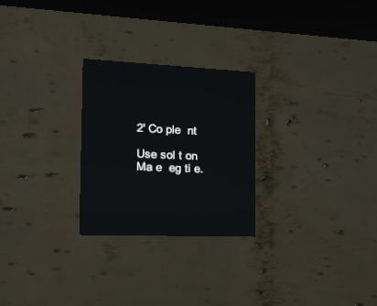
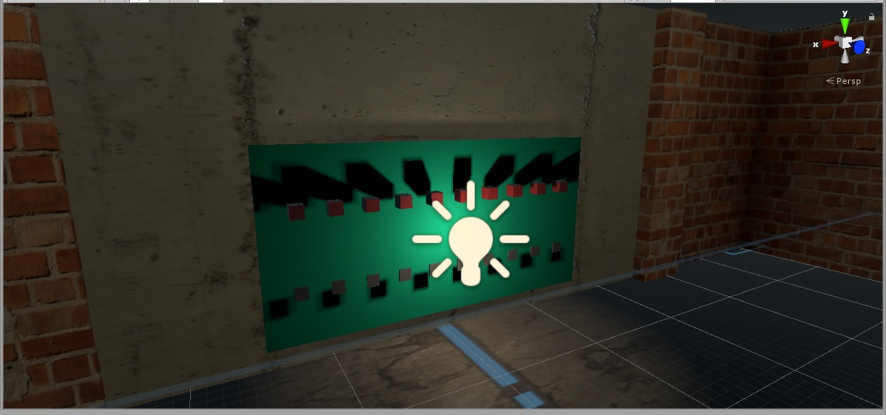
Initial Setup of D2B Puzzle

Slide 37
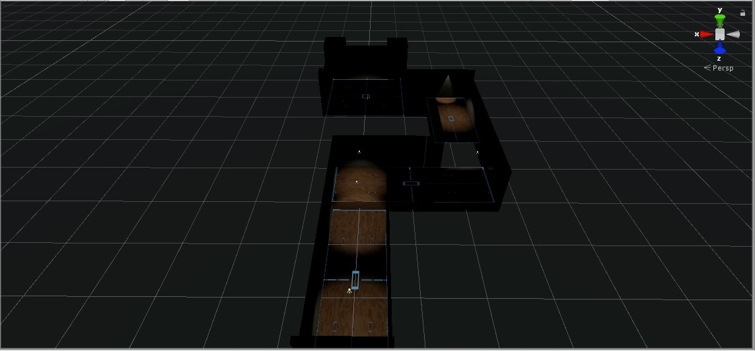
I Made 1 Hallway too Many….
Notes:
Still Going to Use it

Slide 38
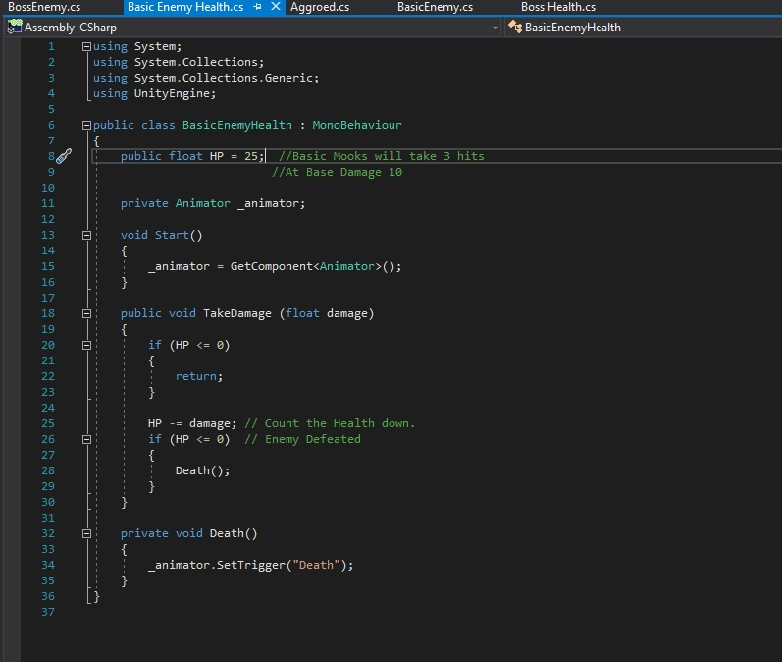
Implementing Enemy COding
First Code showcases its health system
Basic enemies have 25
The boss has 255.
Base weapon damage from player = 10
Increasing to 30 after 4 puzzles.

Slide 39
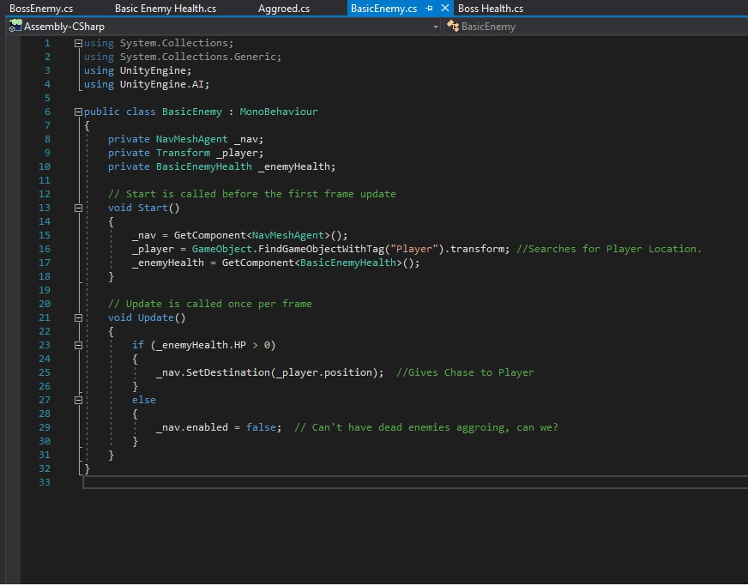
Implementing Enemy Coding
Will pursue the player via mesh grid.
Follows the player until reaching player
Basic enemy does 10 damage
Boss does 30!

Slide 40
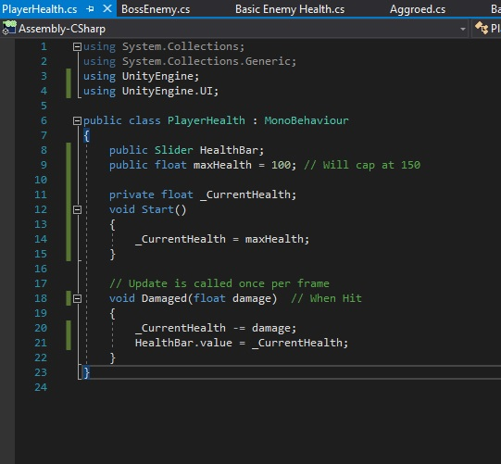
Implementing Player COding
Bases of the Health Bar
Visualized via slider bar
Starts at 100
Caps at 150 after 4 puzzles

Slide 41
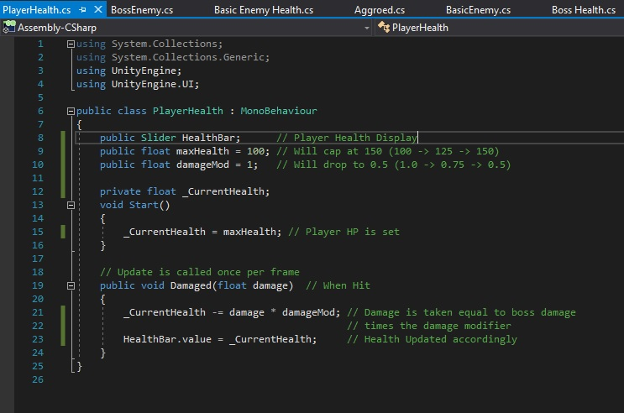
Update on the Player COding
What is damageMod?
A new puzzle reward!
Replaces extra HP rewards
Will go down to half damage after puzzle 3

Slide 42
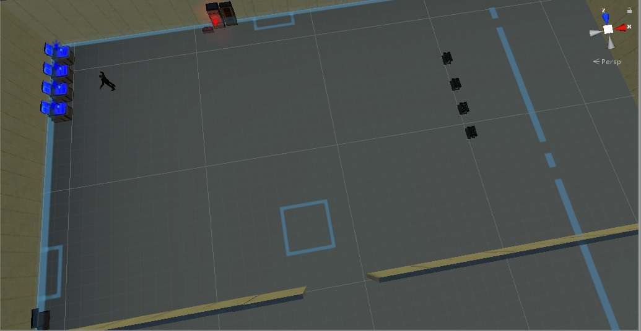
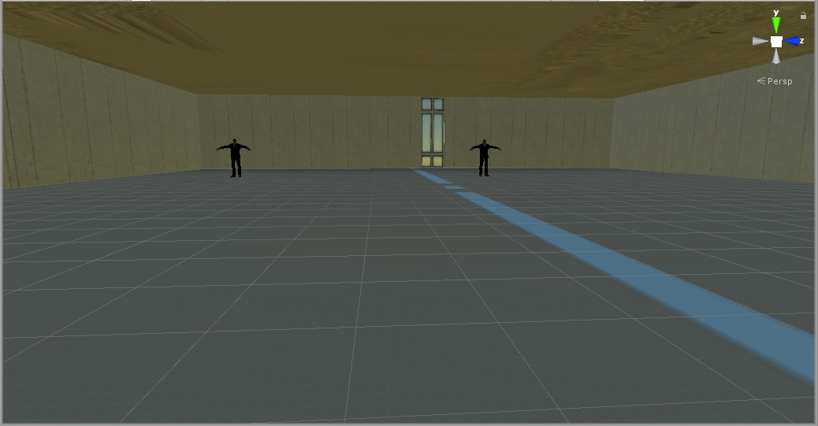
Tour of the Main Lobby

Slide 43
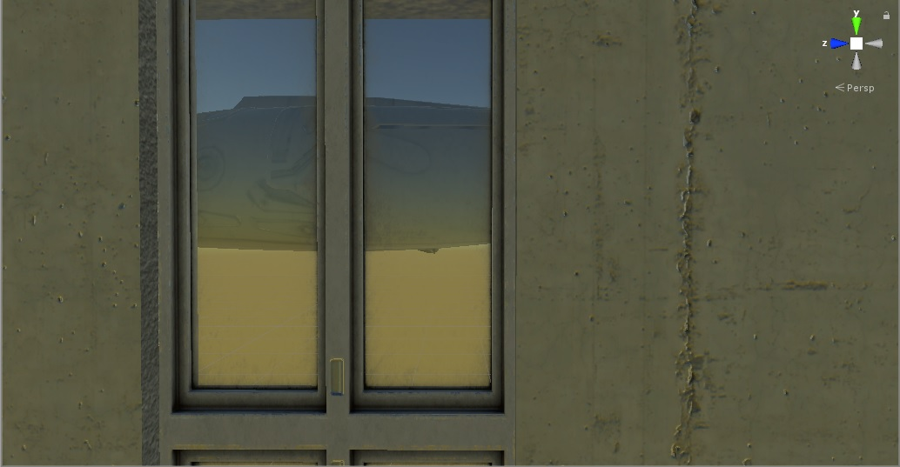
Outside the Front Lobby
What’s this plane doing here?
What’s its destination?
Does this affect the game?

Slide 44
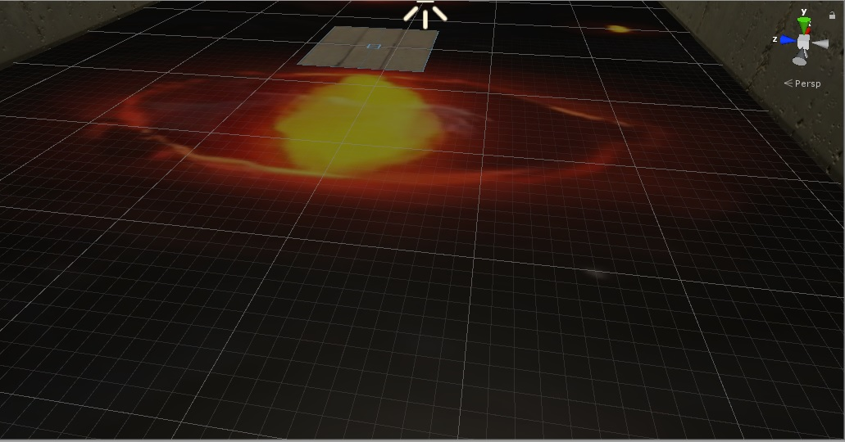
This was in the Facility!?
The Eyes of the Eldritch
How many souls has it consumed?
Would you be next?

Slide 45
Questions?

Slide 46
Thank you for your time!
Notes:
More in the future!

